Slide 1



Slide 2

BUSINESS ANALYTICS Introduction to Business Analytics and Core Business Functions
BUSINESS ANALYSIS REAL WORLD - AGILE WAYS

Slide 3
LEARNING OBJECTIVES – WEEK 13
By the end of today you should be able to:
Understand how Business Analysts operate in real companies
Understand Agile in practice (not theory only)
Know what employers expect from junior Bas
Learn how to behave in projects, meetings, and teams
Feel more prepared for jobs and internships

Slide 4
PREVIOUS WEEKS – 1 -> 12
Last weeks we learned:
✔ Business fundamentals ✔ Stakeholders ✔ Requirements ✔ Documentation ✔ Process modeling ✔ Improvement ✔ Analytics ✔ KPIs ✔ Dashboards ✔ Storytelling
Now we go last mile:
👉 Today we combine everything into real project execution.

Slide 5
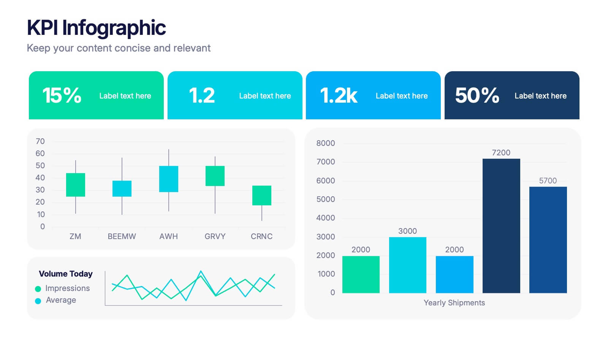
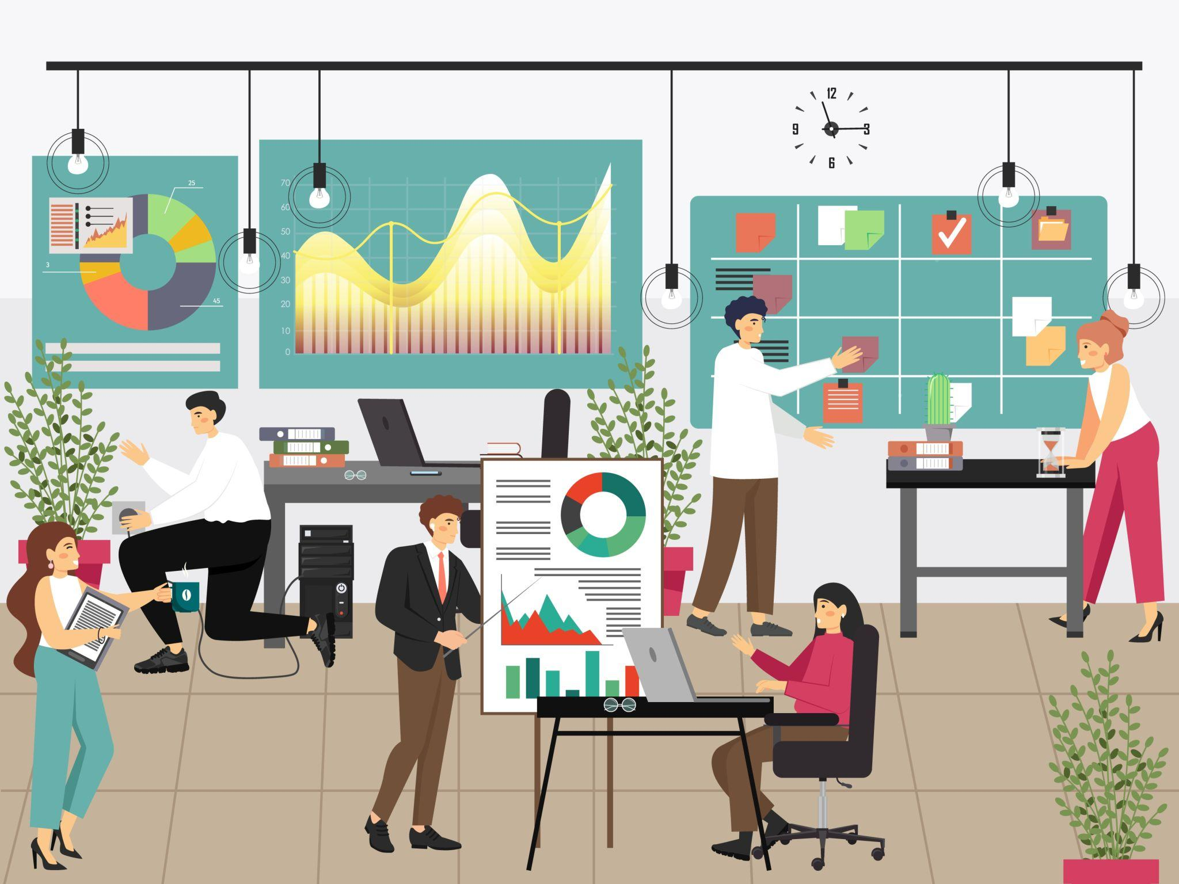
BIG PICTURE: WHAT HAPPENS IN THE REAL WORLD?
University often teaches concepts separately:
Requirements
Stakeholders
KPIs
Reports
But in real jobs, all happen together.
A BA may do in one day:
✔ Attend stakeholder meeting ✔ Clarify user story ✔ Update Jira ticket ✔ Help QA understand scope ✔ Analyze KPI drop ✔ Prepare status update ✔ Join sprint planning

Slide 6
BIG PICTURE: WHAT HAPPENS IN THE REAL WORLD?
🇵🇰 Pakistan Example
Software house in Lahore builds app for UAE client.
BA responsibilities:
Understand overseas client needs
Manage timezone communication
Convert requests into backlog
Support dev team
Demo progress weekly
🌎 Global Example
Product company like Uber:
BA/Product Analyst monitors rider cancellations and proposes improvements using data.

Slide 7

WHAT EMPLOYERS EXPECT FROM A JUNIOR BA
They do NOT expect perfection.
They expect:
✔ Good communication ✔ Structured thinking ✔ Professional attitude ✔ Curiosity ✔ Ability to learn tools ✔ Clear documentation ✔ Reliability
❌ Common Wrong Assumption
“I need 5 years experience.”
No.
Entry-level roles need strong fundamentals + confidence.

Slide 8
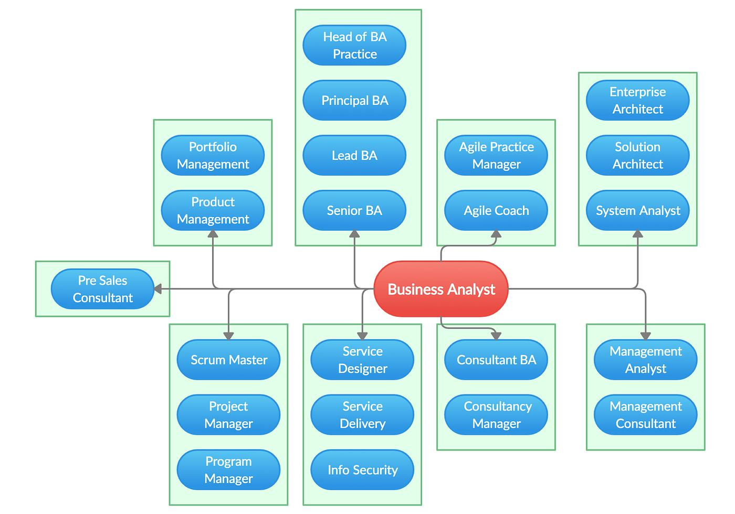
BA PATHWAY

Slide 9
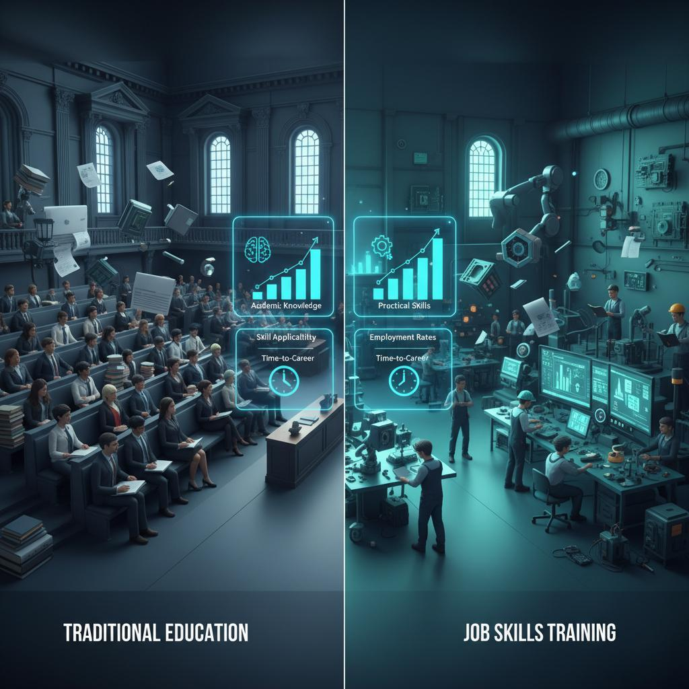
REAL SKILLS VS ACADEMIC SKILLS
Academic | Real World
Write definitions | Solve ambiguity
Answer exam questions | Ask better questions
Learn models | Apply models
Individual work | Cross-functional teamwork

Slide 10
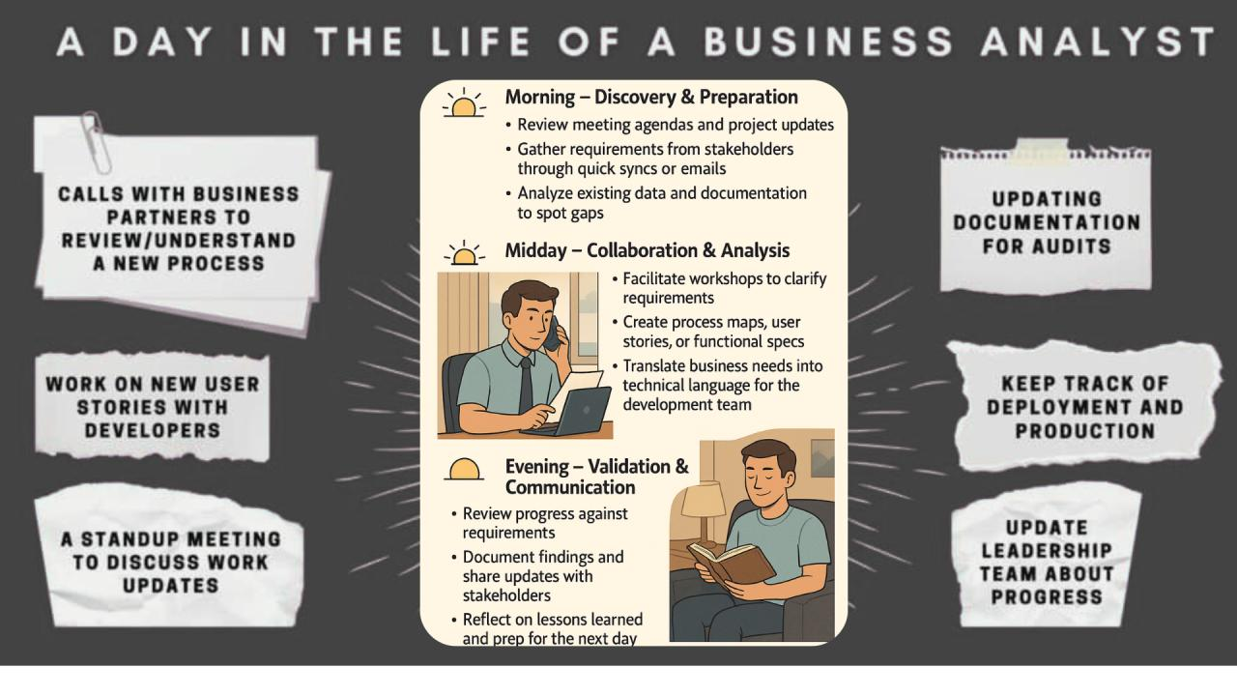
A DAY IN THE LIFE OF A BA
Example daily schedule:
10:00 AM
Check emails, Slack, Jira updates
11:00 AM
Daily standup with team
12:00 PM
Requirement clarification with client
2:00 PM
Write user stories
4:00 PM
Review dashboard metrics
5:00 PM
UAT feedback meeting
6:00 PM
Prepare status summary

Slide 11

STAKEHOLDER MANAGEMENT IN REAL PROJECTS
Who you deal with:
Client
CEO
Product owner
Developers
QA
Designers
Support team
End users
Example Conflict
Client wants launch tomorrow. Developer says needs 1 week. QA says many bugs remain.
BA response:
✔ Clarify priorities ✔ Present trade-offs ✔ Suggest MVP release

Slide 12
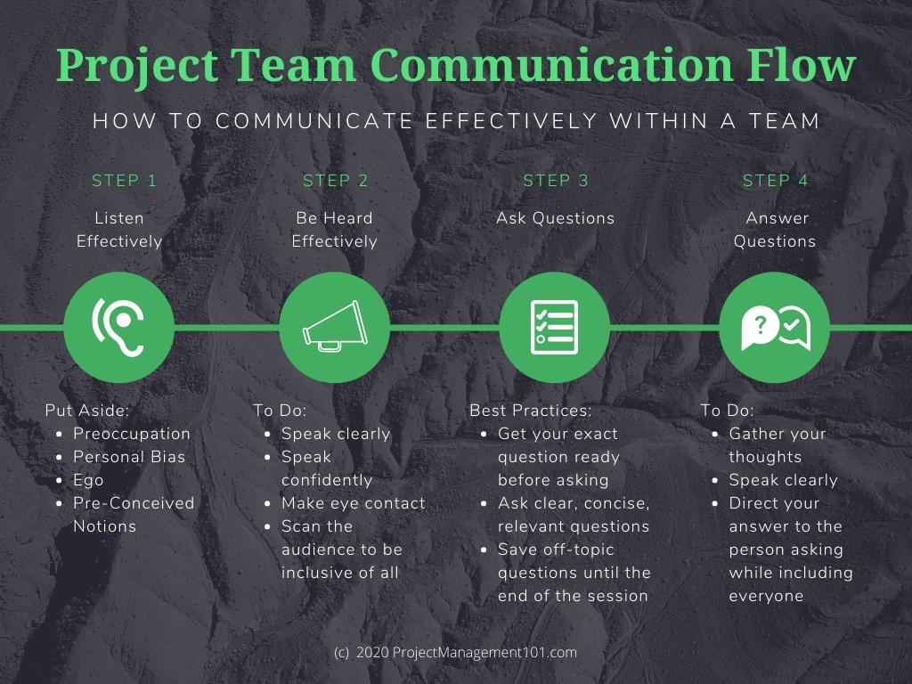
COMMUNICATION SKILLS (HIGHLY IMPORTANT)
Good BA writing is:
✔ Clear ✔ Short ✔ Action-oriented ✔ Structured
Weak Message
“Need update.”
Strong Message
“Please confirm whether payment gateway testing will complete by 3 PM so sprint demo can proceed.”

Slide 13
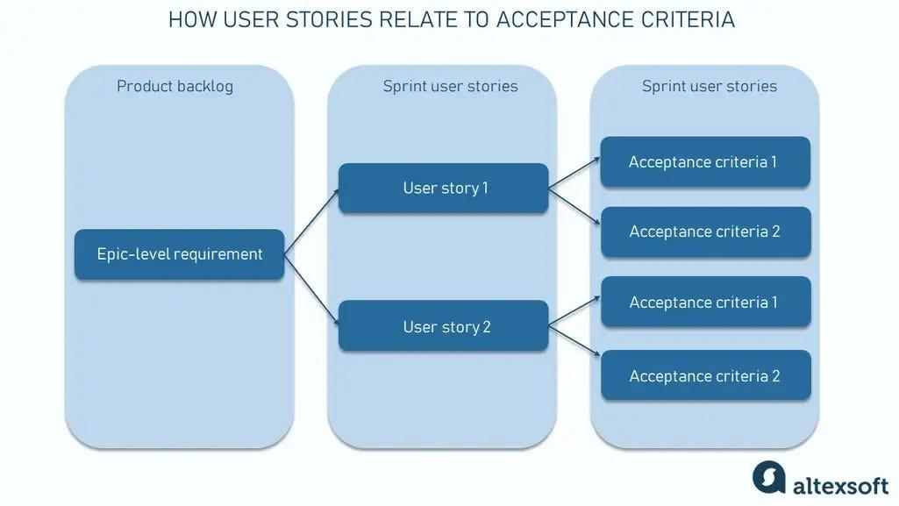
DOCUMENTATION IN REAL PROJECTS
Documents are not made for marks. They are made to reduce confusion.
Examples:
✔ User stories ✔ Acceptance criteria ✔ Process flows ✔ Meeting notes ✔ Decision logs ✔ Change requests
Example User Story
As a customer, I want to save multiple addresses so that checkout is faster.
Acceptance Criteria:
Add up to 5 addresses
Default address selectable
Editable anytime

Slide 14
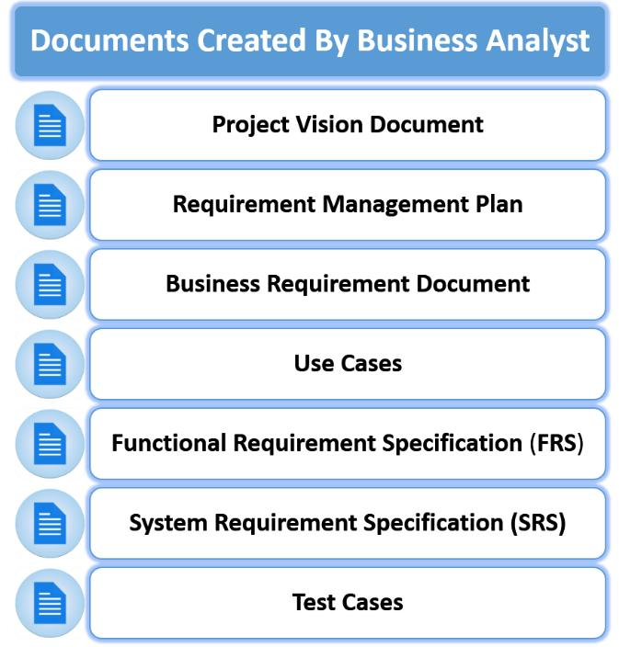
DOCUMENTATION IN REAL PROJECTS

Slide 15
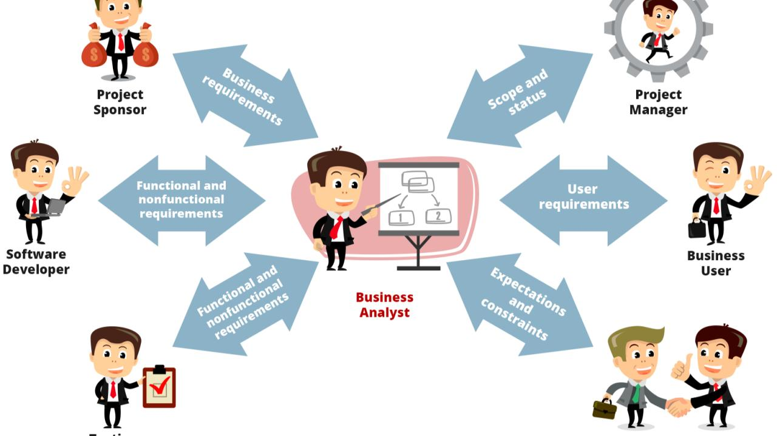
DOCUMENTATION IN REAL PROJECTS

Slide 16
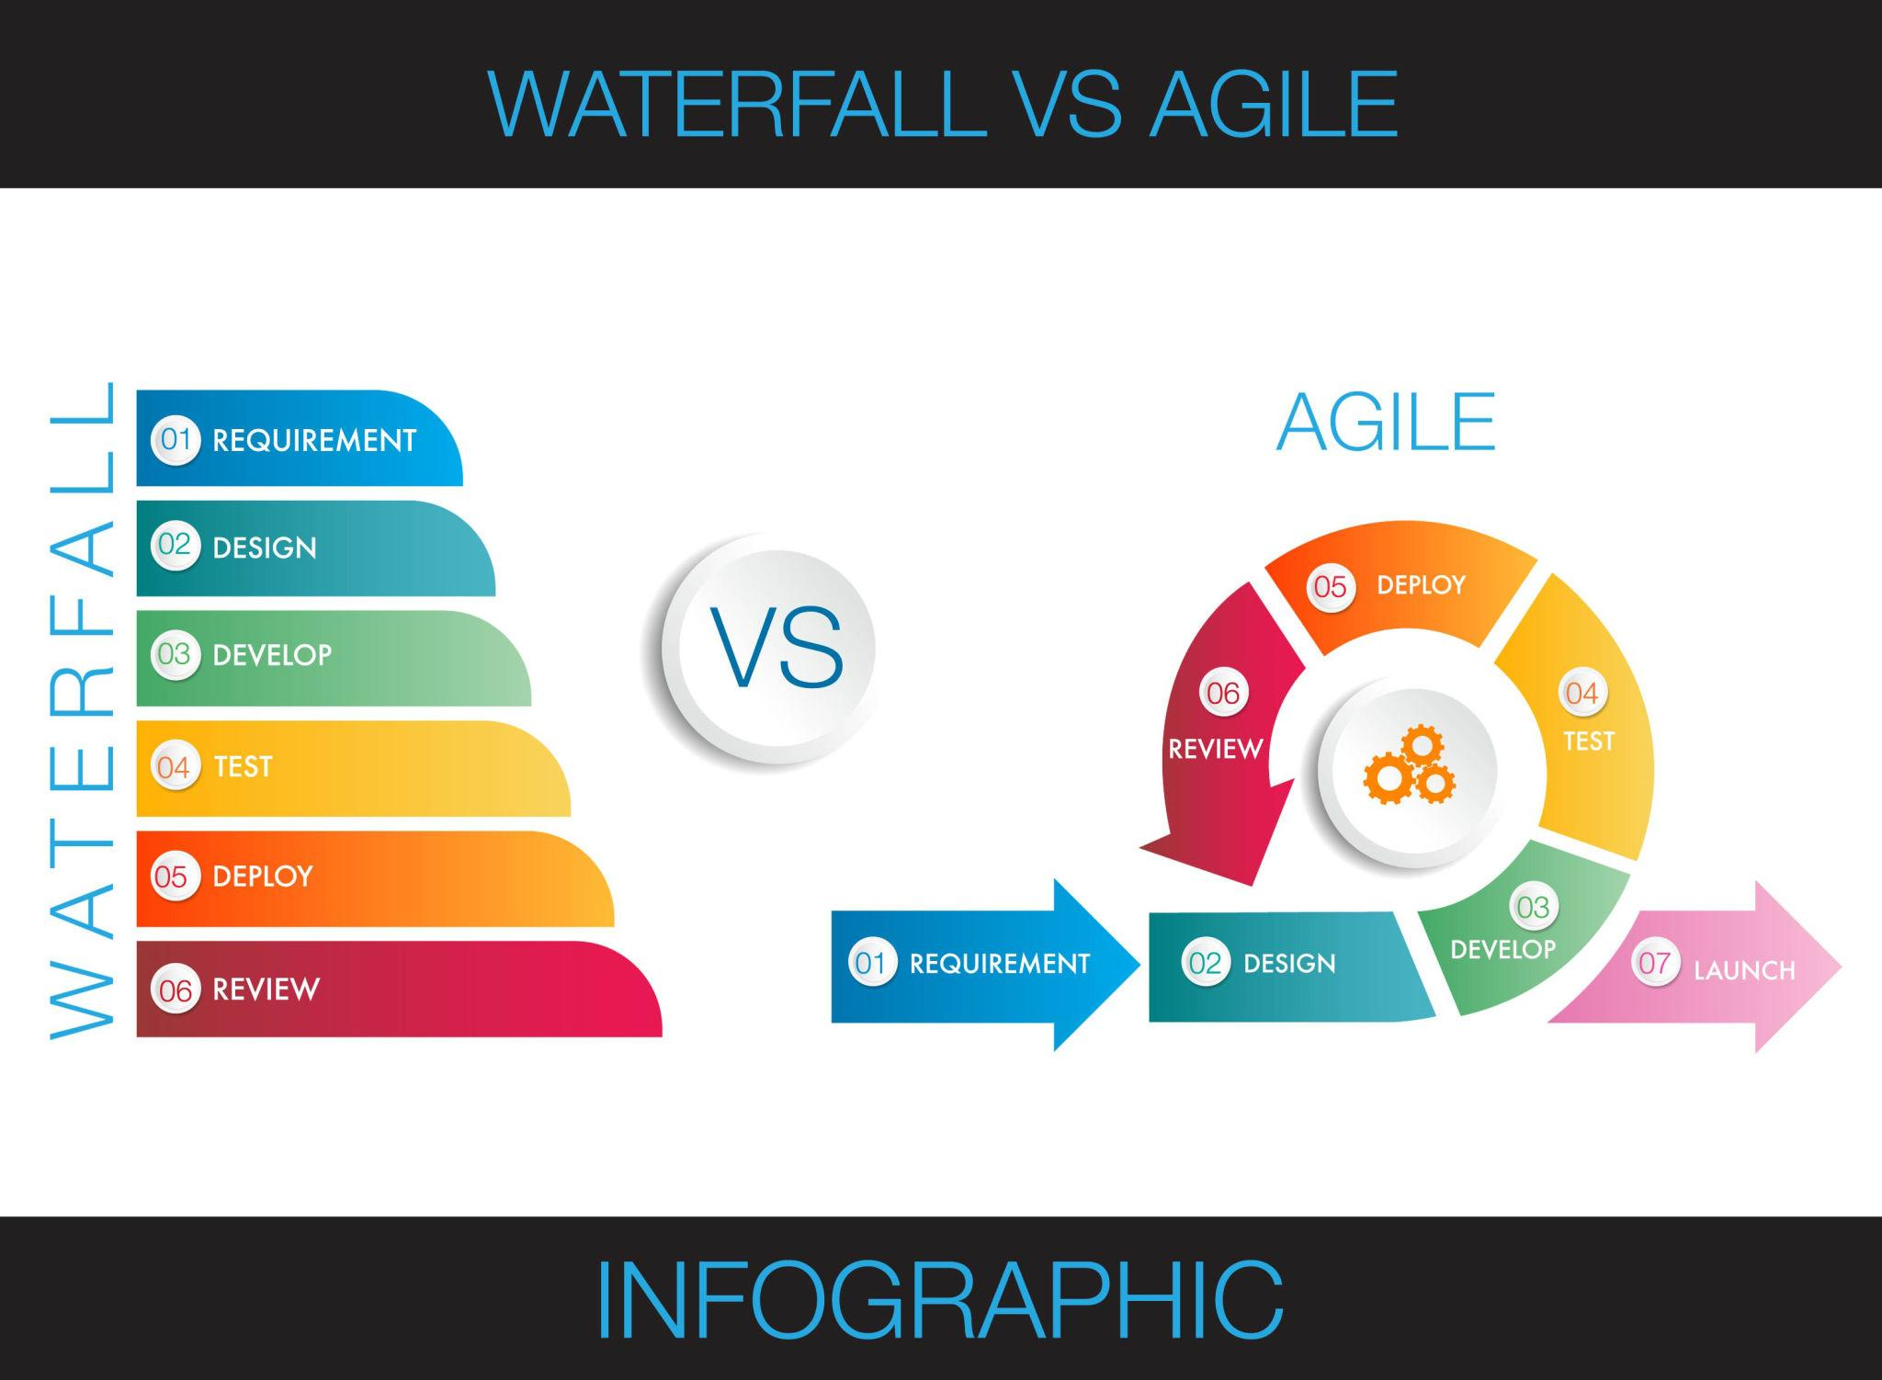
AGILE DEEP DIVE
Agile is not just “fast work”.
Agile = delivering value in small increments with continuous feedback.
Waterfall | Agile
Full scope first | Incremental delivery
Late feedback | Continuous feedback
Big launch | Frequent releases
Hard to change | Adaptable
Example
Waterfall: Build full e-commerce platform in 8 months.
Agile: Release login → cart → payment → tracking step by step.

Slide 17
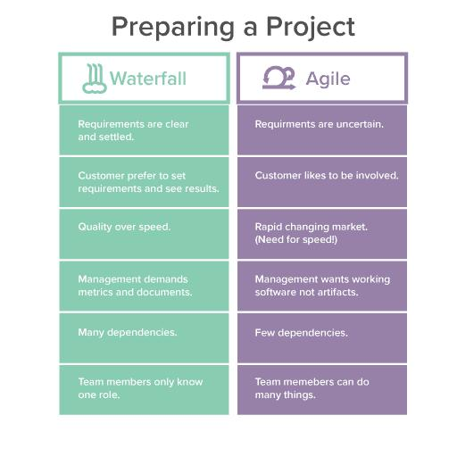
WATERFALL OR AGILE

Slide 18
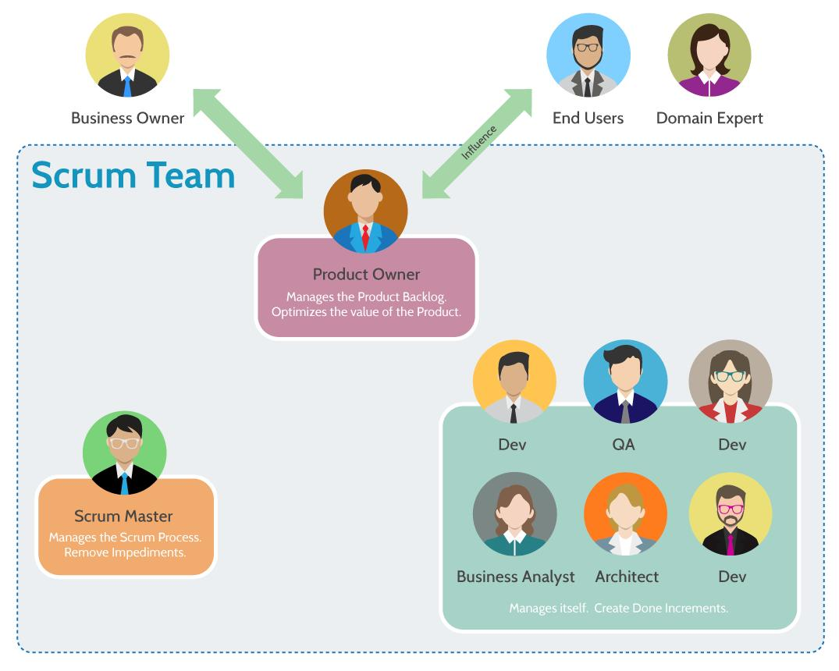
SCRUM FRAMEWORK IN PRACTICE
Product Owner
Defines priorities.
Scrum Master
Improves team process.
Developers
Build solution.
QA
Validates quality.
BA
Clarifies requirements and aligns everyone.

Slide 19
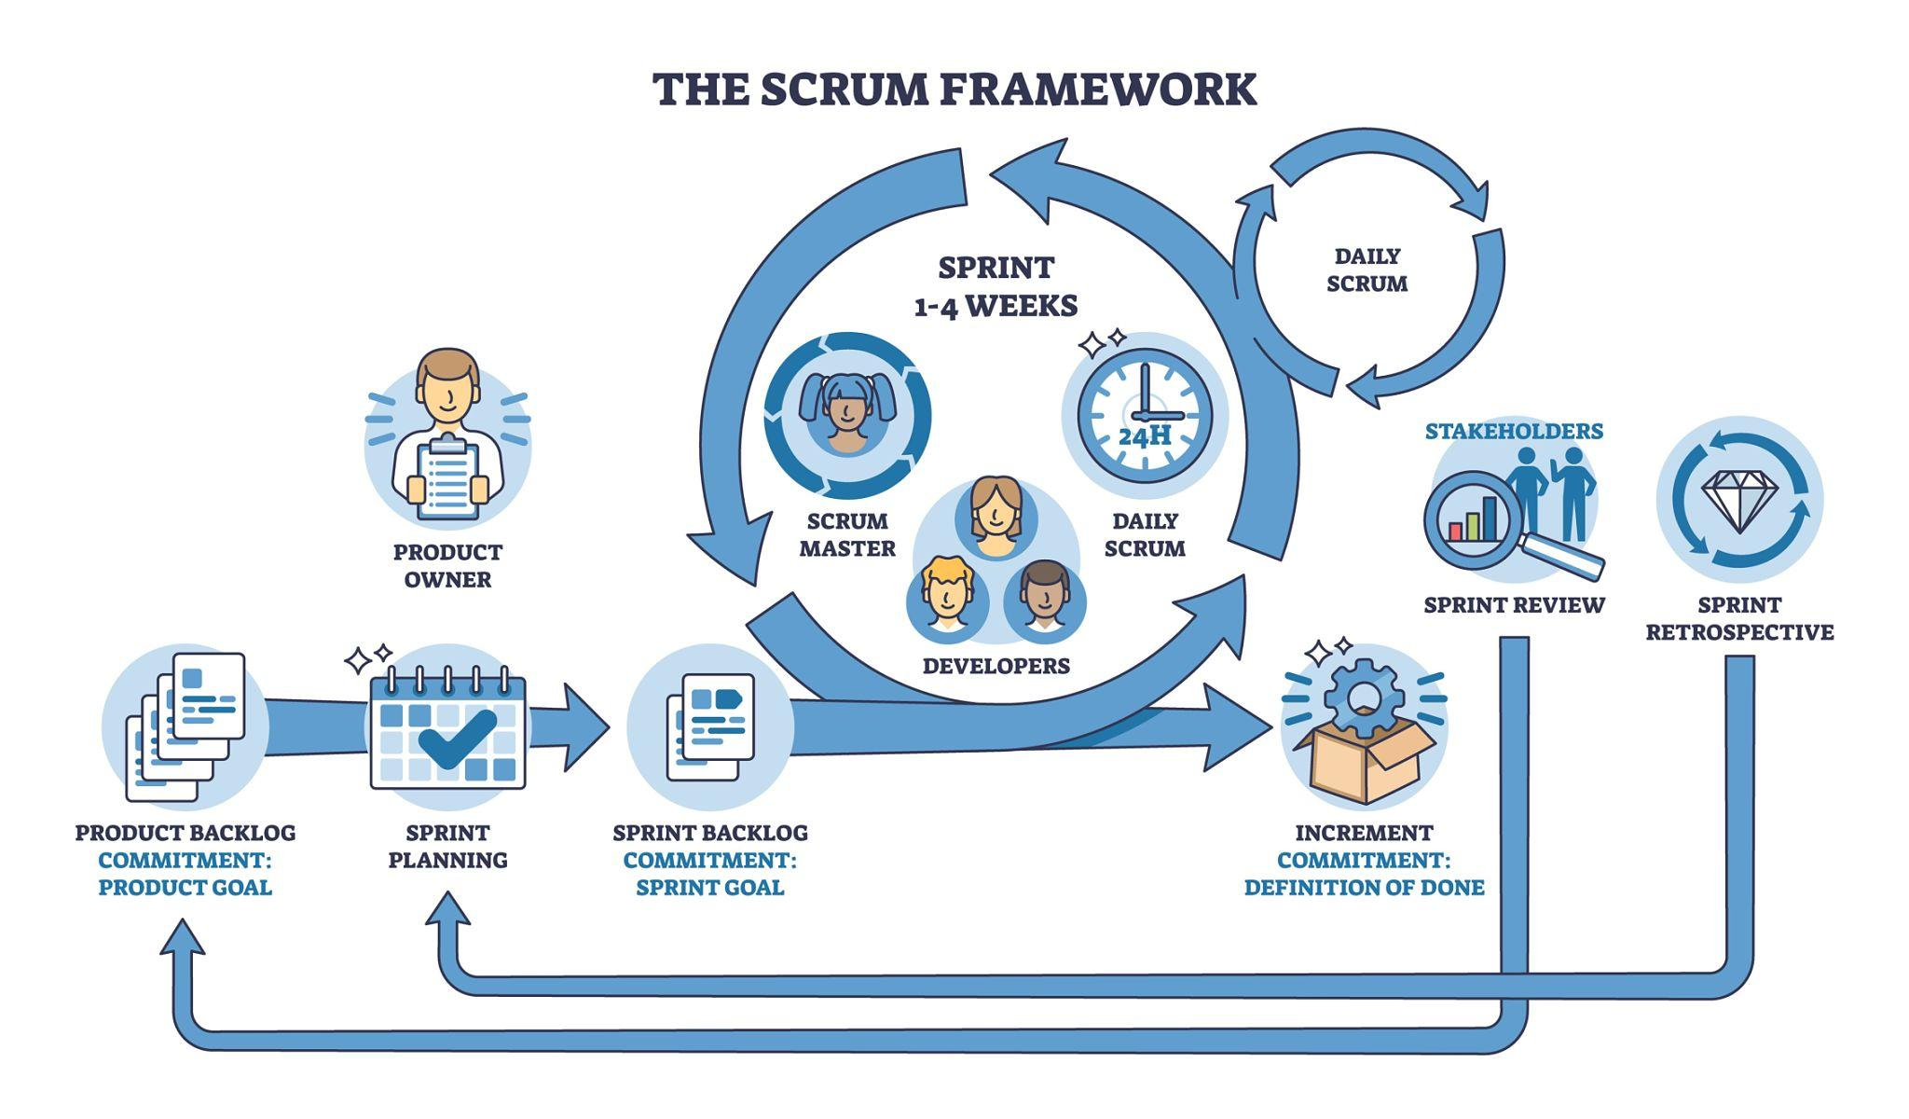
SCRUM FRAMEWORK IN PRACTICE

Slide 20
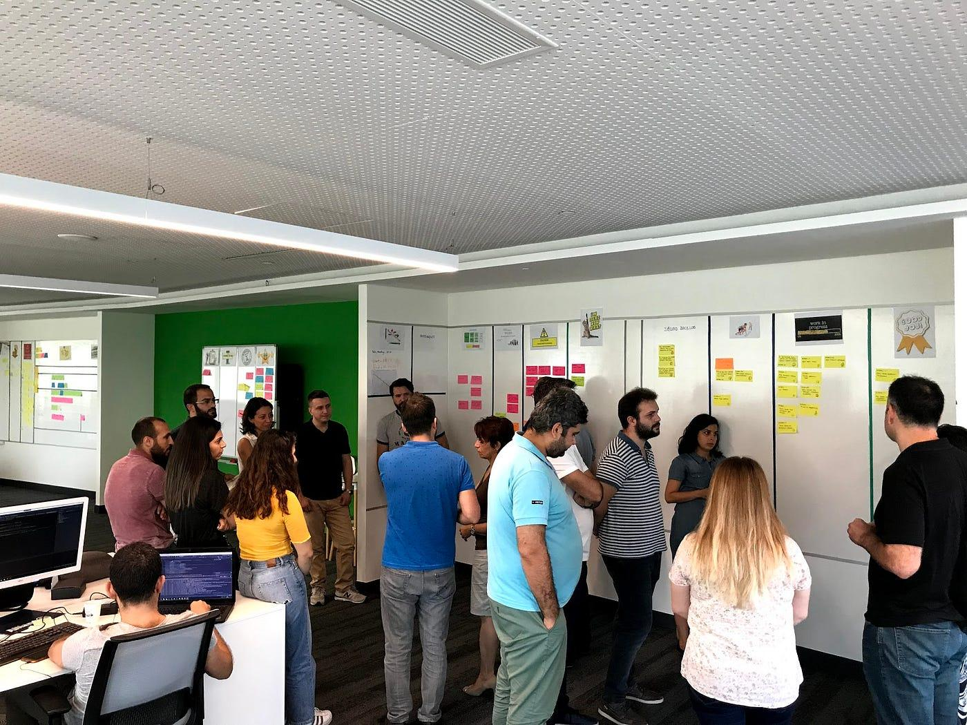
SCRUM CEREMONIES
1️⃣ Sprint Planning
Team selects work for next 2 weeks.
BA role:
✔ Explain stories ✔ Clarify business value ✔ Define acceptance criteria
2️⃣ Daily Standup
3 questions:
What did I do?
What will I do?
Any blockers?
BA role:
✔ Remove ambiguity ✔ Resolve blockers quickly

Slide 21
SCRUM CEREMONIES
3️⃣ Sprint Review
Show completed work.
BA role:
✔ Validate business expectations ✔ Capture feedback
4️⃣ Retrospective
Improve how team works.
BA role:
✔ Identify process issues ✔ Suggest improvements

Slide 22
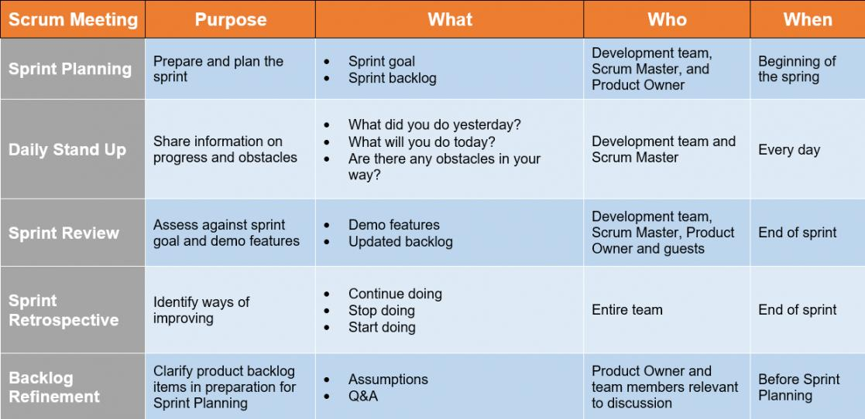
SCRUM CEREMONIES

Slide 23
AGILE REAL SCENARIO
Agile Example
Startup in Karachi launches food app.
Sprint 1: Registration
Sprint 2: Ordering
Sprint 3: Payments
Sprint 4: Tracking
This is real Agile progression.

Slide 24
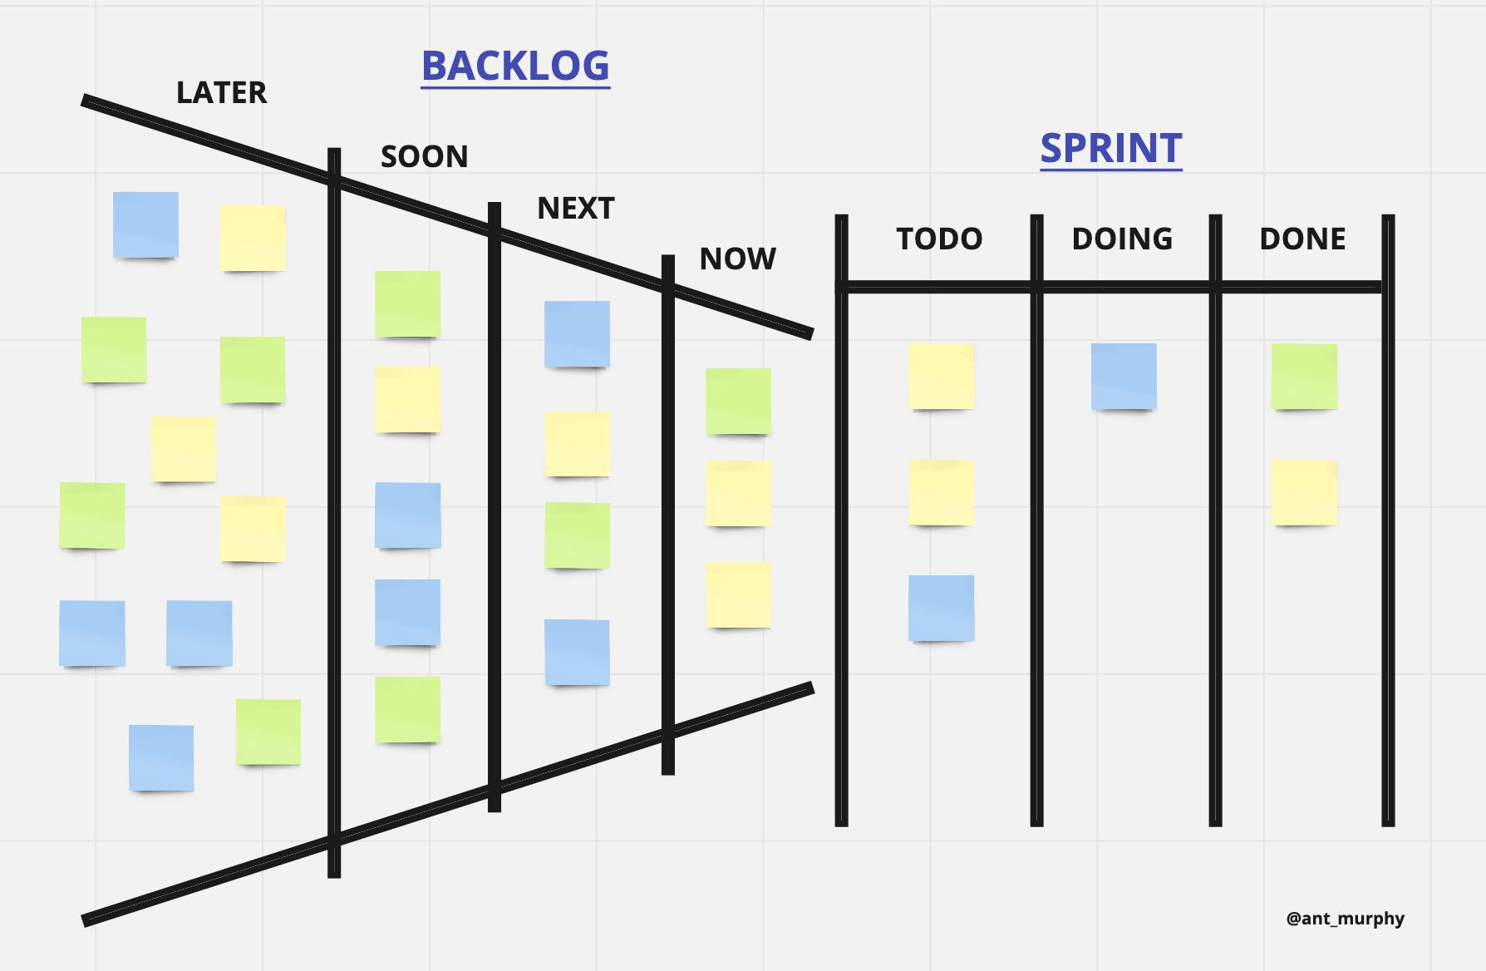
BACKLOG MANAGEMENT
Backlog = list of future work.
BA helps refine items by:
✔ Splitting big features ✔ Clarifying scope ✔ Adding priorities ✔ Defining dependencies
Example Epic
“Improve Checkout”
Broken into:
Save address
Coupon code
Payment retry
Guest checkout

Slide 25
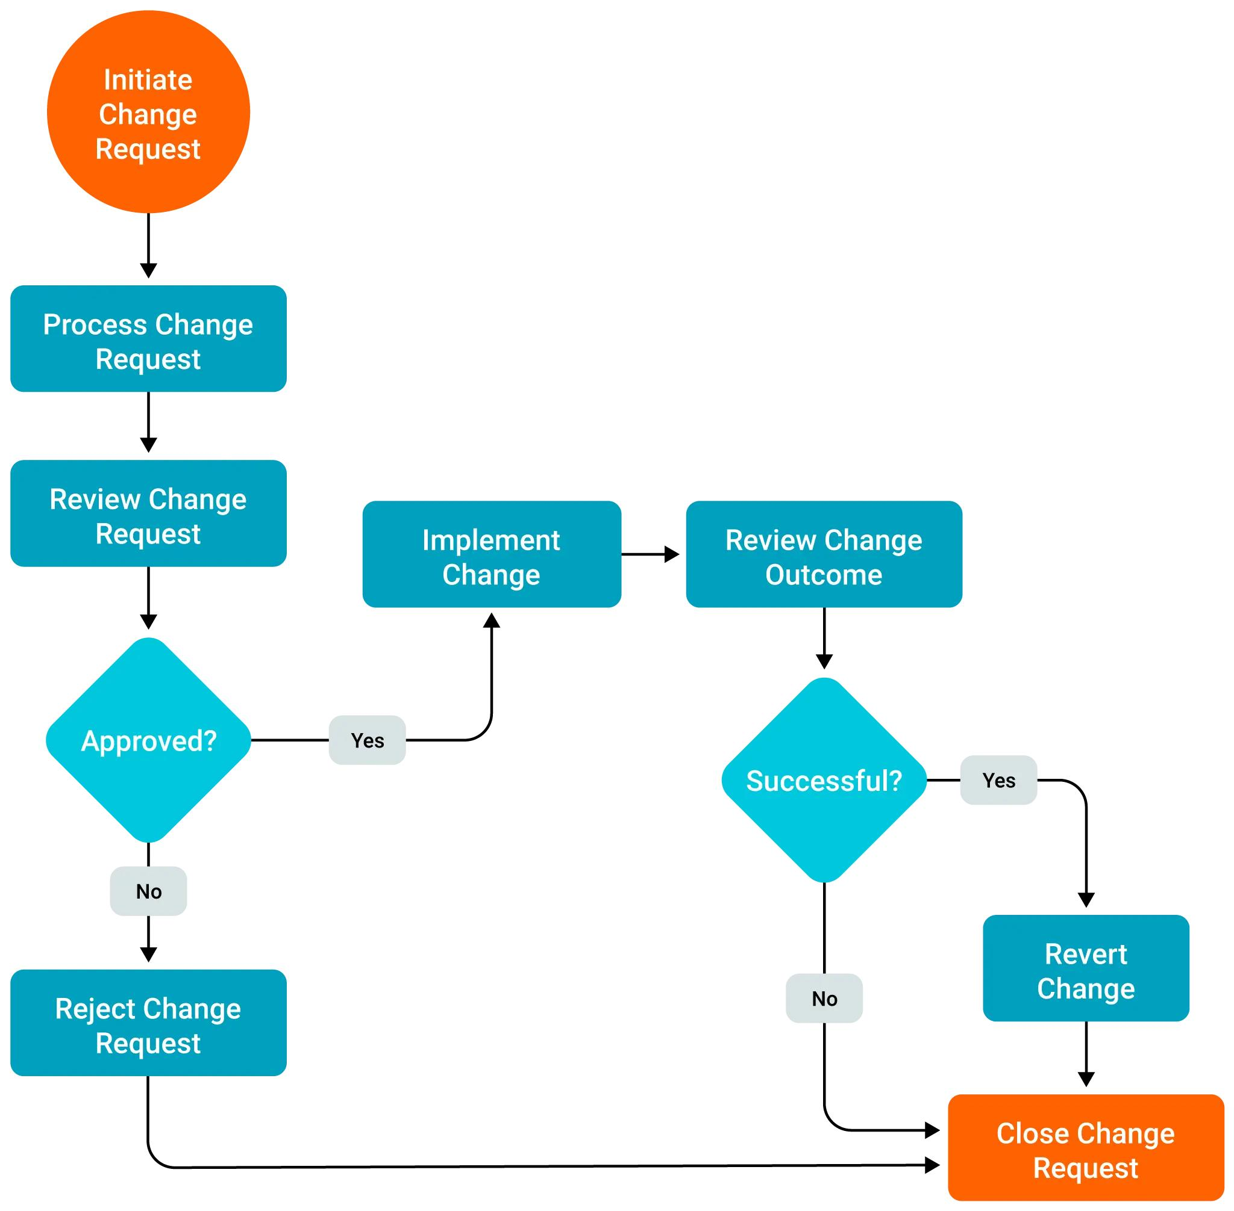
HANDLING CHANGE REQUESTS
Reality:
Requirements change often.
Bad BA says: “That wasn’t in scope.”
Good BA says:
✔ Understand impact ✔ Estimate effort ✔ Reprioritize backlog ✔ Communicate trade-offs

Slide 26
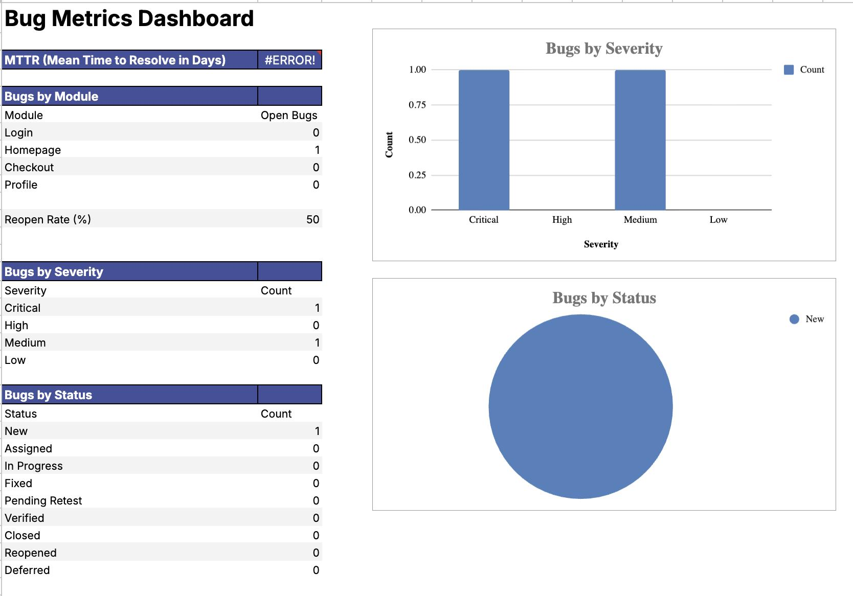
BA + DATA IN AGILE TEAMS
Modern BA uses data.
Examples:
Drop-off rate
Delivery time
Bug trends
User retention
Example
Checkout abandonment = 40%
BA investigates friction points.

Slide 27

INTERVIEW READINESS SECTION
Q: What does a BA do?
Answer: A BA identifies business needs, gathers requirements, improves processes, and ensures solutions create value.
Q: Agile vs Waterfall?
Explain delivery model + feedback difference.
Q: How handle difficult stakeholder?
Listen, clarify concerns, align on priorities, document decisions.
Q: Example KPI for delivery app?
Delivery time
Cancellation rate
Retention rate

Slide 28
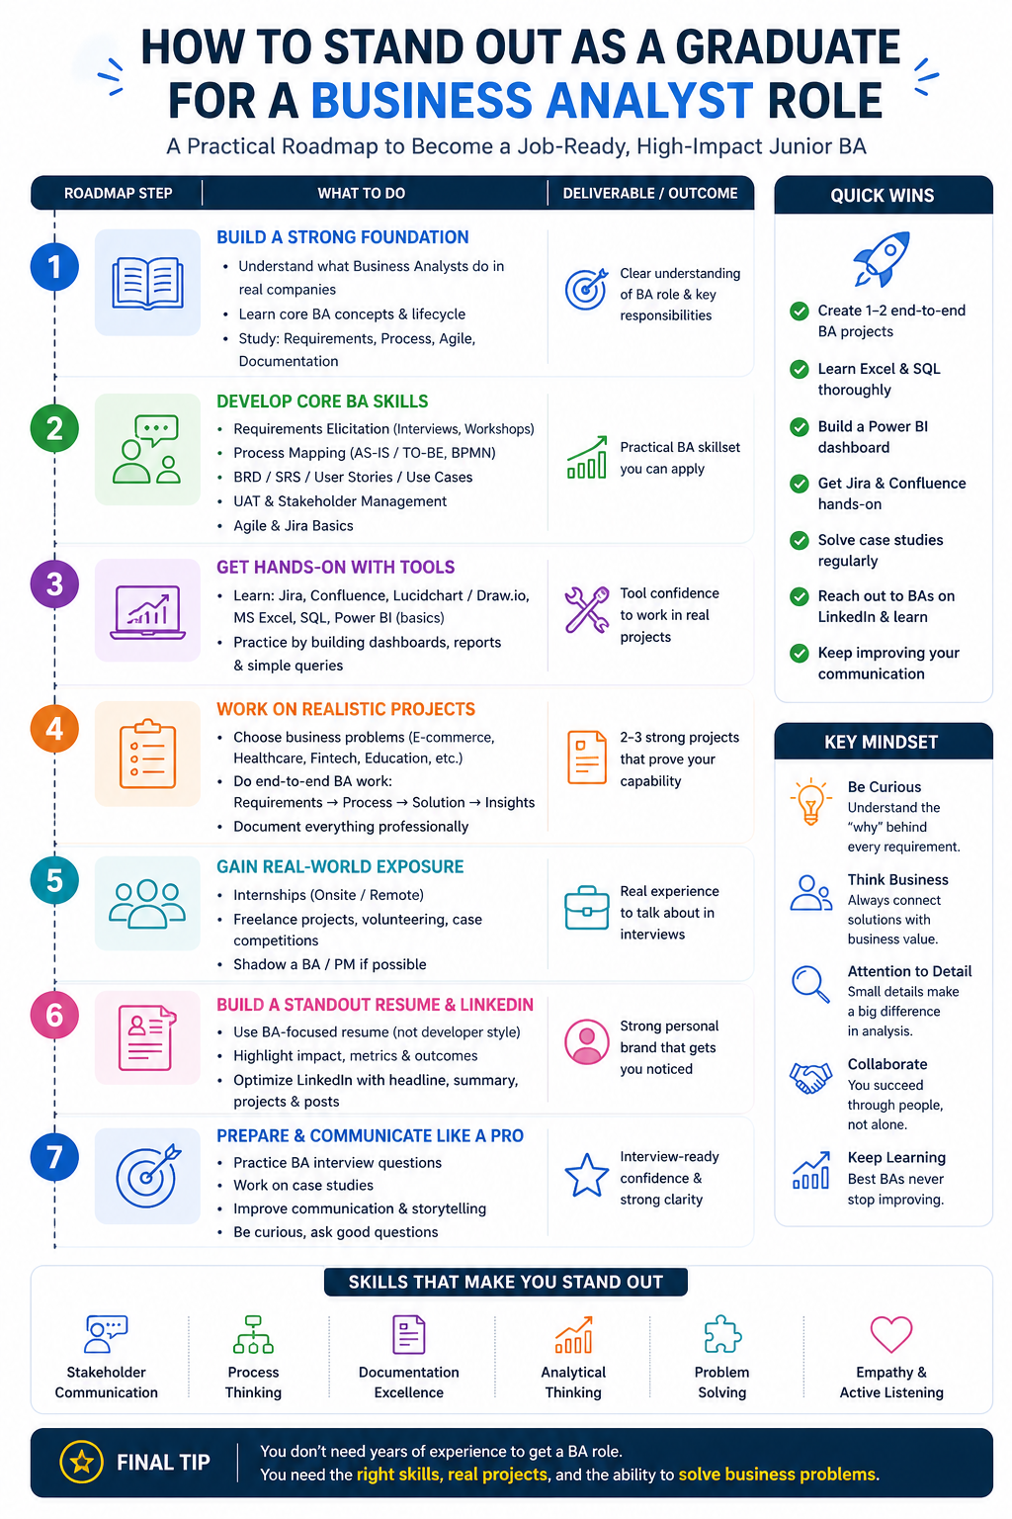
HOW TO STAND OUT AS A GRADUATE
Build portfolio with:
✔ Sample BRD ✔ User stories ✔ Process diagram ✔ Dashboard mockup ✔ Capstone project
Also improve:
✔ LinkedIn profile ✔ Communication ✔ Confidence

Slide 29
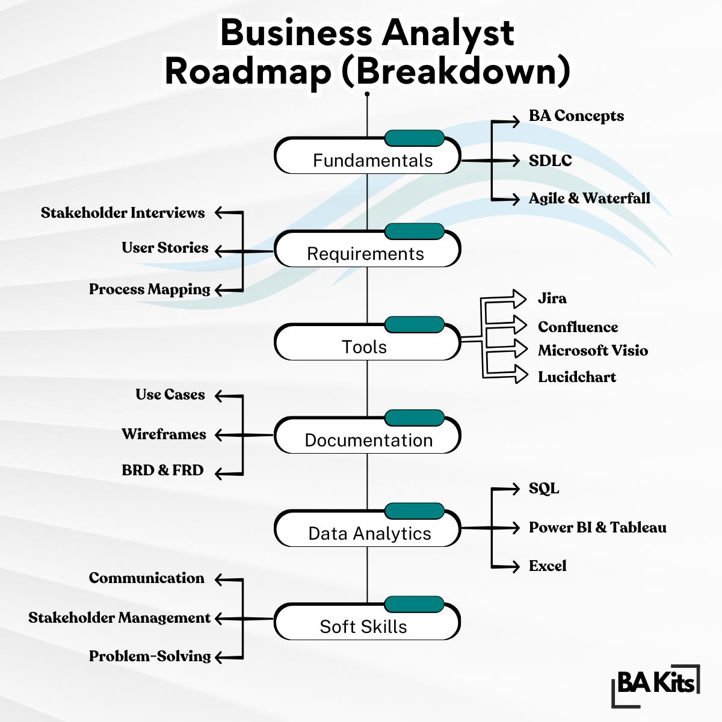
HOW TO STAND OUT AS A GRADUATE

Slide 30
COMMON RESUME MISTAKES
1. Bad File Name
Examples: Resume Final.pdf, CV Latest.docx, BA Resume (1).pdf ✅ Use: FullName_JrBA_Resume.pdf
2. Sending Word File
❌ .docx ✅ Always send PDF
3. No Clear Target Role
Resume says “Student” instead of Junior Business Analyst
4. Weak Summary
Generic lines like “motivated student” ✅ Mention BA skills + value
5. Poor Structure
Wrong order / cluttered sections ✅ Best order: Summary → Skills → Experience → Projects → Education
6. Too Much Theory
Lists skills but no proof
❌ Stakeholder management ✅ Conducted stakeholder interviews for 5 users
7. No Metrics
❌ Created dashboard ✅ Built dashboard tracking 12 KPIs
8. Developer Resume as BA Resume
Too much coding/tools, little business analysis
9. Missing BA Keywords
Use terms like:
BRD
SRS
User Stories
BPMN
UAT
Jira
Agile

Slide 31
COMMON RESUME MISTAKES
10. Responsibilities Only
❌ Worked with team ✅ Reduced delays / improved process / clarified requirements
11. Poor Formatting
Dense text, no spacing, hard to scan
12. Grammar / Spelling Errors
Major red flag
13. Unprofessional Email
❌ coolboy123@gmail.com ✅ firstname.lastname@gmail.com
14. No Customization
Same resume sent for every job

Slide 32
REAL MISTAKES NEW BAS MAKE
❌ Writing unclear requirements ❌ Accepting vague requests ❌ Not asking follow-up questions ❌ Over-documenting simple work ❌ Ignoring stakeholder alignment ❌ Focusing only on tools

Slide 33
Activity
Prepare a 3-5 lines answer (w/o use of chatgpt) :
“If I join a company as Junior BA, how will I add value in first 30 days?”
This answer can become your interview script.

Slide 34
KEY TAKEAWAYS (END OF LECTURE)
✔ BA is one of the most practical business-tech careers ✔ Agile needs communication + clarity ✔ Employers value mindset more than memorization ✔ You are closer to industry-ready than you think ✔ Start practicing now
“Real projects are messy — that’s why BAs are valuable.”
“The best analysts stay calm in ambiguity.”
“Tools can be learned. Mindset is harder to teach.”
“Communication is often the real bottleneck.”

Slide 35
“Your degree gives you knowledge. Your mindset gets you hired.”

